Slide 1
Chapter 1
Introduction

Slide 2

Objectives for Chapter 1
Identify strategies you can use to set yourself up for success in learning statistics
Distinguish between descriptive and inferential statistics
Define population, sample, parameter, statistic, and variable as they are used in statistics
Distinguish between quantitative and categorical variables
Distinguish between continuous and discrete variables
Identify the lower and upper limits of a continuous variable
Identify four scales of measurement and distinguish among them
Distinguish between statistics and research design
Distinguish between correlational and experimental research designs
Define independent variable, dependent variable, and extraneous variable and identify them in research studies
Describe statistics’ place in epistemology
Identify ways in which statistics is a dynamic and controversial field
1

Slide 3
Our Textbook
Exploring Statistics: Tales of Distributions (13th ed.) will be your guidebook for this class. Here’s how to make the most out of this resource:
  Read chapters before class
    Utilize active reading strategies: Take notes, write down questions you have, try to anticipate what you should learn from each section
  Work through all practice problems
    Do not look up the answer before working a problem yourself
  At the end of each chapter, check your comprehension of chapter objectives
  Additional problems are available through the free online study guide
2

Slide 4

But, I’m not a hiker!
If you’re nervous about this class because you’re nervous about math, keep the following in mind:
You do not need to consider yourself a “math person” to succeed in learning statistics
You can brush up on your math skills by engaging with Appendix A
Asking for help when you need it is a sign of self-awareness and strength
Try reframing your anxiety: Because so many people have doubts about their math and statistical abilities, this course is an opportunity for you to set yourself apart from your peers by mastering a skillset that is very marketable across a wide range of professions.
4-5

Slide 5
Descriptive vs. inferential statistics
Descriptive statistics
Inferential statistics
A number that conveys a particular characteristic of data, meant to organize and summarize a set of data
e.g., Mean: The arithmetic average of a set of data; sum of scores divided by the number of scores
Method that uses sample evidence and probability to reach conclusions about unmeasurable populations
5-6

Slide 6
Populations vs. samples
Population
Sample
All measurements of a specified group
e.g., all first-grade students in the United States
Populations are who researchers are ultimately trying to learn about, but they are often impractical or impossible to measure.
Measurements of a subset of a population
e.g., 50 first-grade students in the United States
Samples are what we rely on when we can’t assess the full population of interest.
6

Slide 7
Null hypothesis significance testing
Null hypothesis significance testing (NHST) is an inferential statistics technique that draws yes/no conclusions about research questions based on probability:
Yes, there seems to be an effect present
OR
No, there does not seem to be an effect present
Throughout Chapters 9-15, you will learn to apply this process to different types of research designs.
7

Slide 8
Some additional terminology
Parameter
Statistic
Numerical or nominal characteristic of a population
e.g., mean reading readiness score of all first-grade students in the United States
Parameters only change if the population changes
Numerical or nominal characteristic of a sample
e.g., mean reading readiness score of 50 first-grade students in the United States
Statistics are used to estimate parameters and tend to differ from one sample to another
8

Slide 9
Some additional terminology 2
Variables: Something that exists in more than one amount or in more than one form
Quantitative variable
Categorical variable
Variable whose scores indicate different amounts
Variable whose scores differ in kind, not amount (e.g., eye color, political affiliation)
Continuous variable: A quantitative variable whose scores can be any amount (e.g., memory)
Discrete variable: A quantitative variable for which intermediate values between scores are not meaningful (e.g., number of siblings)
Also known as Qualitative variable
8-10

Slide 10
Some additional terminology 3
Continuous quantitative variables have lower limits and upper limits
Lower limit: Bottom of the range of possible values that a measurement on a continuous variable can have
Upper limit: Top of the range of possible values that a measurement on a continuous variable can have
9

Slide 11
Test your understanding:
Foundational terminology in statistics
Identify the appropriate statistical terminology to describe each of the items below. You may need to use more than one term to fully describe an item.
Terminology options
Descriptive statistics
Inferential statistics
Population
Sample
Parameter
Statistic
Continuous quantitative variable
Discrete quantitative variable
Categorical variable
Item
Average number of questions answered correctly on the first statistics exam
Predicted winner of an election, based on exit polls
Average number of books owned by the students in your class
Terminology
Population parameter, descriptive statistic, continuous quantitative variable
Sample statistic, inferential statistic, categorical variable
Population parameter, descriptive statistic, discrete quantitative variable
5-10

Slide 12
Scales of measurement
Numbers mean different things in different situations:
What number were you wearing in the race? “5”
What place did you finish in? “5”
How many minutes did it take you to finish? “5”
These numbers mean different things because they each represent a different scale of measurement.
11

Slide 13
Scales of measurement 2
Nominal scale: Measurement scale in which numbers serve only as labels and do not indicate any quantitative relationship (e.g., political affiliation)
Ordinal scale: Measurement scale in which numbers indicate the order of scores and serve as ranks; equal differences between numbers do not represent equal differences between the things measured (e.g., finish places in a race)
Interval scale: Measurement scale in which equal differences between numbers represent equal differences between the things measured. The zero point is arbitrarily defined (e.g., ratings of sleep quality could be assessed on a 5-point scale ranging from 1-5 or 0-4)
Ratio scale: Like interval scales, equal differences between numbers represent equal differences between the things measured; but zero means that none of the thing measured is present (e.g., number of hours slept last night)
12-13

Slide 14
Scales of measurement 3
14

Slide 15
Who cares about scales of measurement?
You do!
Knowing about scales of measurement helps you:
choose the correct statistical analysis for your data
  e.g., You’ll learn in Chapter 3 that the mean (arithmetic average) does NOT work for nominal data
appropriately interpret the results of your statistical analyses
choose the correct graphical presentation for your data
12-14

Slide 16
Test your understanding:
Scales of measurement
Variable
Hours slept last night
College major
Favorite ice cream flavor
Liking of the color blue
Ranking of your top 5 favorite books
Course credits earned
Level of self-esteem
Race results (1st, 2nd, 3rd, etc.)
Scale of measurement
Ratio
Nominal
Nominal
Interval
Ordinal
Ratio
Interval
Ordinal
12-14

Slide 17
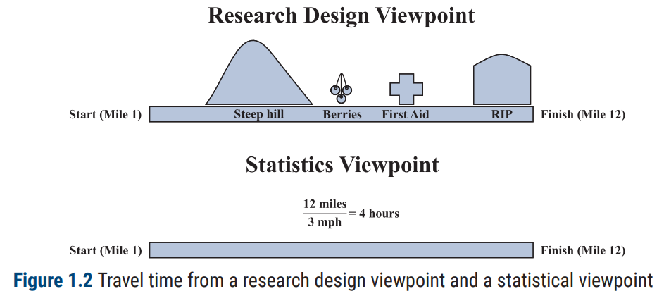
Statistics and research design
Statistics
Research design
involves the manipulation of numbers and the conclusions based on those manipulations
deals with all the things that influence the numbers you get. Knowing the basics of research design is important when interpreting statistical analysis
14-15

Slide 18
Types of research designs and variables
Correlational study: Research design wherein all variables are measured variables
Experimental study: Research design wherein at least one variable is a manipulated variable
A simple experiment has two major variables:
Independent variable: Variable controlled by the researcher; changes in this variable may produce changes in the dependent variable
Values of the independent variable are usually called levels or conditions and sometimes treatments
Dependent variable: Observed variable that is expected to change as a result of changes in the independent variable in an experiment
Extraneous variable: Variable other than the independent variable that may affect the dependent variable
16-18

Slide 19
Test your understanding:
Types of research designs and variables
The study: You want to improve your spaghetti sauce. You investigate whether swapping in brown sugar for white sugar will make a difference. At one gathering the sauce contains brown sugar; at the other gathering, the sauce contains white sugar.
Is this a correlational or experimental study? How do you know?
What is the independent variable?
How many levels of the IV are there?
What is the dependent variable?
Identify one possible extraneous variable.
16-18

Slide 20
Test your understanding:
Types of research designs and variables 2
The study: You want to know if sleepy people have trouble driving. You investigate by varying how much people sleep and then having them play a driving simulator game. One group is kept awake all night (0 hours of sleep), a second group of people slept 4 hours, and a third group slept 8 hours. Then you compare the average simulator game scores for the three groups.
Is this a correlational or experimental study? How do you know?
What is the independent variable?
How many levels of the IV are there?
What is the dependent variable?
Identify one possible extraneous variable.
16-18

Slide 21
Statistics and philosophy
Epistemology: The study or theory of the nature of knowledge
Statistics is a way to acquire knowledge and better understand the world—through mathematics and logical reasoning
Although statistical methods, themselves, are reliable tools, tools can be misused. In other words, how people interpret and present statistics can be unreliable.
A great advantage of studying statistics is that you get better at recognizing statistics that are used improperly.
18-19

Slide 22
What you will learn on our journey
Kirk (2008) identifies four levels of statistical sophistication:
Category 1: those who understand statistical presentations
Category 2: those who understand, select, and apply statistical procedures
Category 3: applied statisticians who help others use statistics
Category 4: mathematical statisticians who develop new statistical techniques and discover new characteristics of old techniques
At the end of this course, you will be well along the path to becoming a Category 2 statistician.
19-20

